Slide 1

A B1 INTERMEDIATE LESSON
How
YOU
learn.
SPEAKING & PERSONAL LANGUAGE
90 minutes · Day 1, Lesson 2
→ Reflect on a language you've learned
→ Notice what works for YOU
→ Plan your next month of English
LESSON PACK · 12 slides · An original lesson

Slide 2
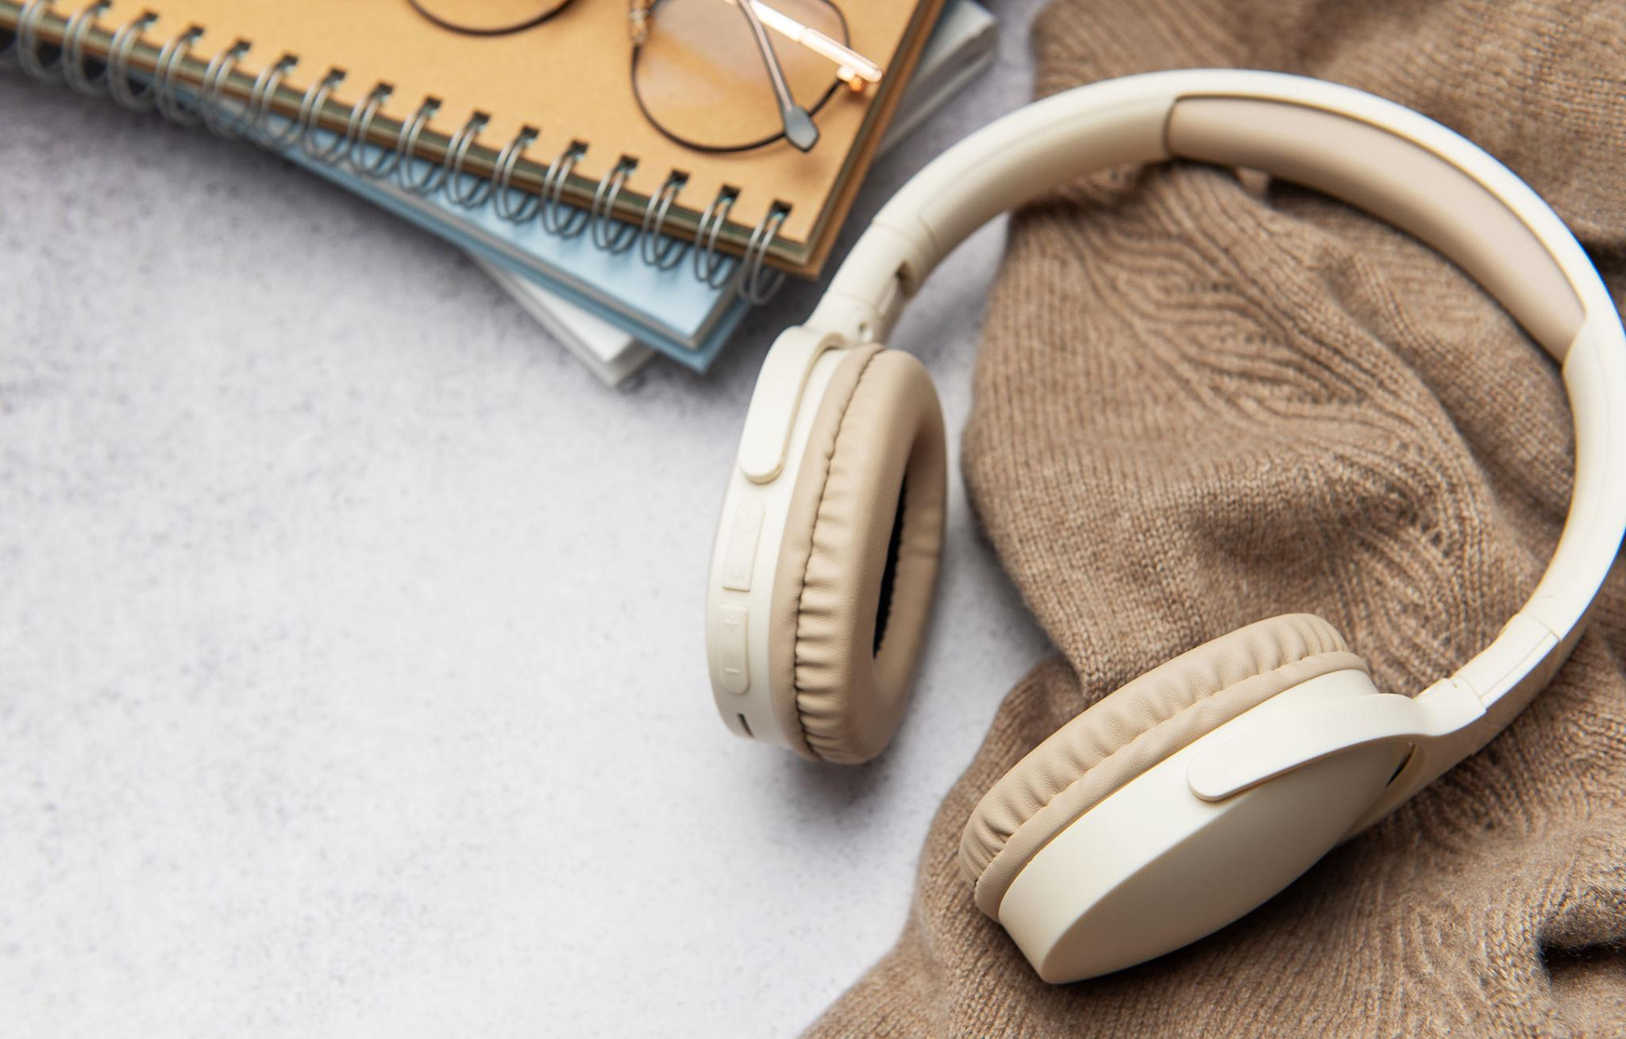
LEAD-IN · 8 MIN
How do YOU learn a language?
Rank these from most helpful (1) to least helpful (5) for you.
?
Watching films and TV in the language
?
Talking to people who speak it
?
Using apps (like Duolingo, Babbel)
?
Travelling to a country that speaks it
?
Lessons with a teacher
Then tell your partner. What's your number 1? Why?
HOW YOU LEARN | B1 INTERMEDIATE
2

Slide 3

PRE-TASK · 12 MIN
Have you ever learned another language?
Think about a language you (or someone you know) tried to learn, could even be English.
TALK WITH YOUR PARTNER
1
Which language? When did you start? Why?
2
What was the hardest part? What was easier than you thought?
3
What helped you the most?
4
What kept you going, or made you stop?
"I started learning… because…" · "The hardest thing was…" · "What helped me was…"
HOW YOU LEARN | B1 INTERMEDIATE
3

Slide 4
SHARE · 8 MIN
What surprised you about your partner?
Tell the class one thing they said that you didn't expect.
WHAT TO DO
USEFUL LANGUAGE
1. Choose ONE thing your partner said.
· I was surprised that my partner started learning…
2. Tell the class, but don't say their name.
· Something I didn't expect was…
3. Did anyone in the room have something in common?
· The most interesting thing they said was…
· We had something in common, we both…
4. Was there a strategy you'd like to try yourself?
· I'd like to try [their strategy] because…
HOW YOU LEARN | B1 INTERMEDIATE
4

Slide 5



BRIEF · 4 MIN
What actually works?
Three things research tells us. Tick what you do, star one to add to your plan.
Little and often.
Find things you almost understand.
Speak, even when you're not sure.
Your brain remembers more when you practise often, even just a few minutes.
Read or listen to material that's a bit hard, but not too hard. That's where new words stick.
Mistakes are part of it. Silent practice doesn't build speaking. Your mouth has to do the work.
15 minutes every day > 2 hours on Sunday.
A children's book. A podcast for learners. English subtitles.
With a classmate. With your teacher. Out loud, alone.
✓ Tick the ones you already do. ★ Star ONE to add to your plan.
HOW YOU LEARN | B1 INTERMEDIATE
5

Slide 6
REMEMBER · 3 MIN
First conditional.
First conditional for real possibilities in the future.
FORM
If +
present simple
, will + base verb
Some examples about learning:
If I watch films in English, I'll improve my listening.
If I'm afraid of mistakes, I won't speak.
I'll learn faster if I practise every day.
HOW YOU LEARN | B1 INTERMEDIATE
6

Slide 7
LANGUAGE FOCUS · 8 MIN
Make it true for YOU.
Complete each sentence with your own ideas, then share with your partner.
1. If I _________________ every day, I'll _________________.
WORDS YOU CAN USE
ACTIONS
practise · read · watch
listen to · speak · write
travel · study · try
2. I'll _________________ if I _________________ more.
3. If I don't _________________, I won't _________________.
RESULTS
improve · get better
understand · remember
feel confident · forget
4. My English will improve if I _________________.
Be specific. Be honest.
HOW YOU LEARN | B1 INTERMEDIATE
7

Slide 8
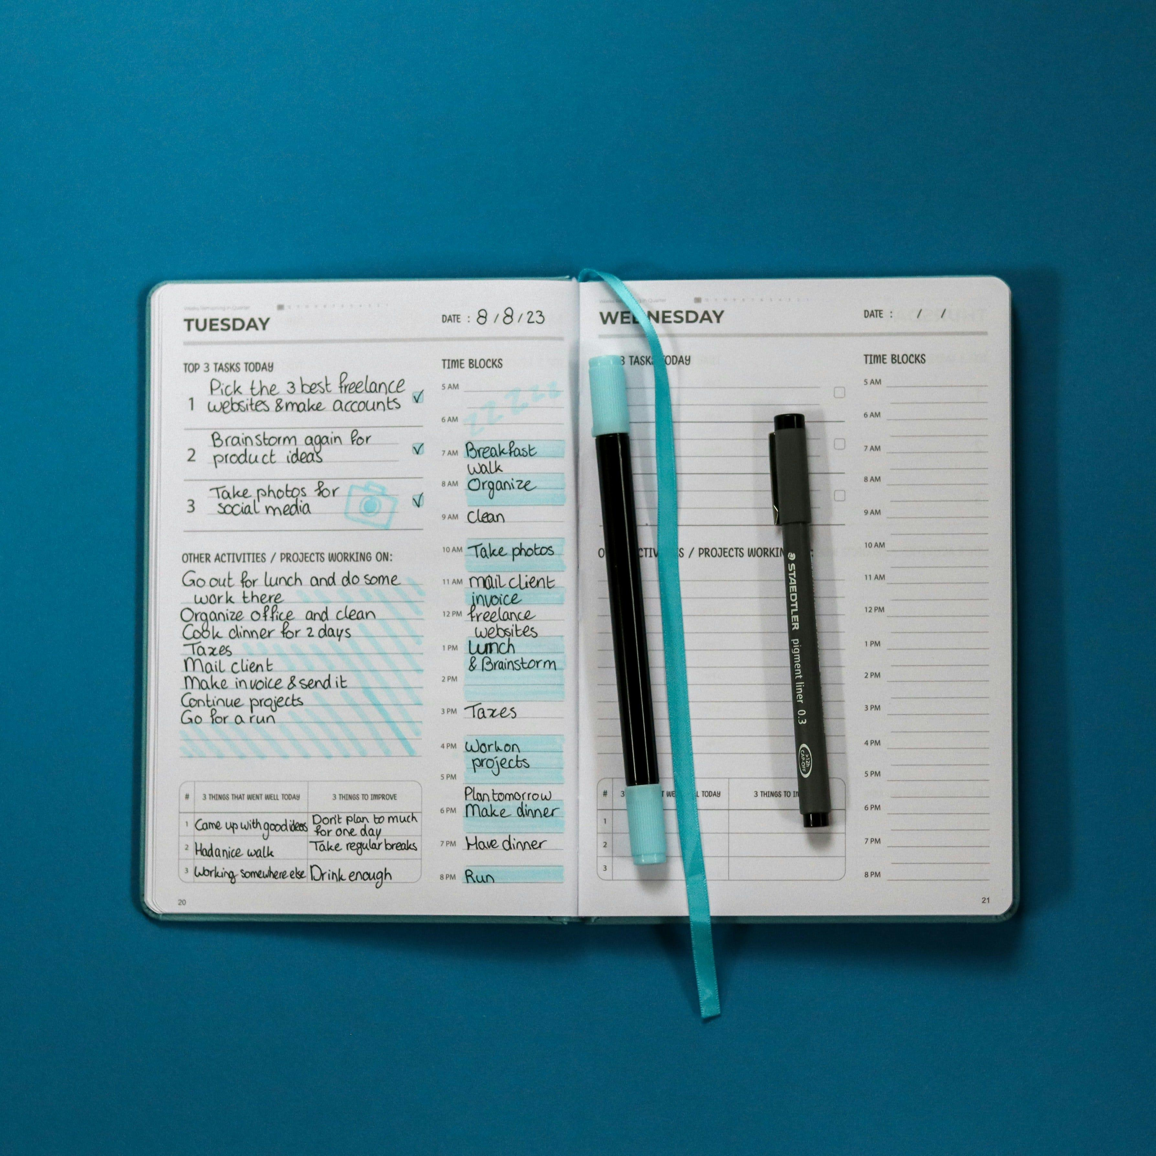
MAIN TASK · 20 MIN
Your English plan for this month.
Real plans only. Write them down. Tell your partner.
YOUR TASK
USEFUL LANGUAGE
Write 5 plans for your English this month.
WHEN
every day · every morning
before bed · on the bus
at the weekend
For each one, use the first conditional to say what will happen if you do it. Be specific about WHEN and WHERE.
"If I [action] [when/where], I'll [result]."
HOW LONG
for 10 minutes · for 30 minutes
for an hour
EXAMPLES
· If I watch one Netflix episode in English every evening, I'll improve my listening.
ACTIONS
· If I write one diary entry a week, I'll get more confident at writing.
read · watch · listen to
talk to · write · practise
HOW YOU LEARN | B1 INTERMEDIATE
8

Slide 9
SHARE · 7 MIN
Make a promise.
Tell your partner your plan. Choose one of theirs to check on next week.
1
2
3
Tell
Listen
Promise
Tell your partner your top 3 plans. Don't read them. Say them naturally.
Listen to theirs. Ask one question. "How will you do that?" or "When exactly?"
Choose ONE plan from your partner's list. Promise to ask them next week if they did it.
"I promise I'll [their plan]. Ask me next week!"
HOW YOU LEARN | B1 INTERMEDIATE
9

Slide 10
WRAP-UP · 4 MIN
Three takeaways.
What stays with you from this lesson?
01
02
03
You know how YOU learn.
First conditional is your tool.
Plans only matter if you do them.
Different things work for different people. Use what works, and stop doing what doesn't.
"If I do X, I'll get Y." Use it for plans, predictions, and promises about the future.
Tell someone. Make it real. Promise. Then come back next week and tell them what happened.
HOW YOU LEARN | B1 INTERMEDIATE
10

Slide 11
REFLECTION · 5 MIN
Three questions for your partner.
Two minutes each direction. Then write one sentence each.
WHAT?
SO WHAT?
NOW WHAT?
What's one thing about your learning you didn't know before today?
Why does it matter for your English?
If you keep your promise this week, what will be different next Monday?
HOW YOU LEARN | B1 INTERMEDIATE
11

Slide 12
Take your plan with you.
Come back to it every week.
HOW YOU LEARN · B1 INTERMEDIATE · DAY 1, LESSON 2

